Slide 1
KHATRA ADIBASI MAHAVIDYALAYA
B.A Program in Physical Education
Name of the Teacher- TITHI ROY
Subject- Physical Education
Semester - III
Course Title: Yogasana and Gymnastics
Topic: Unit- I: YOGASANA
Session: 2021-22

Slide 2

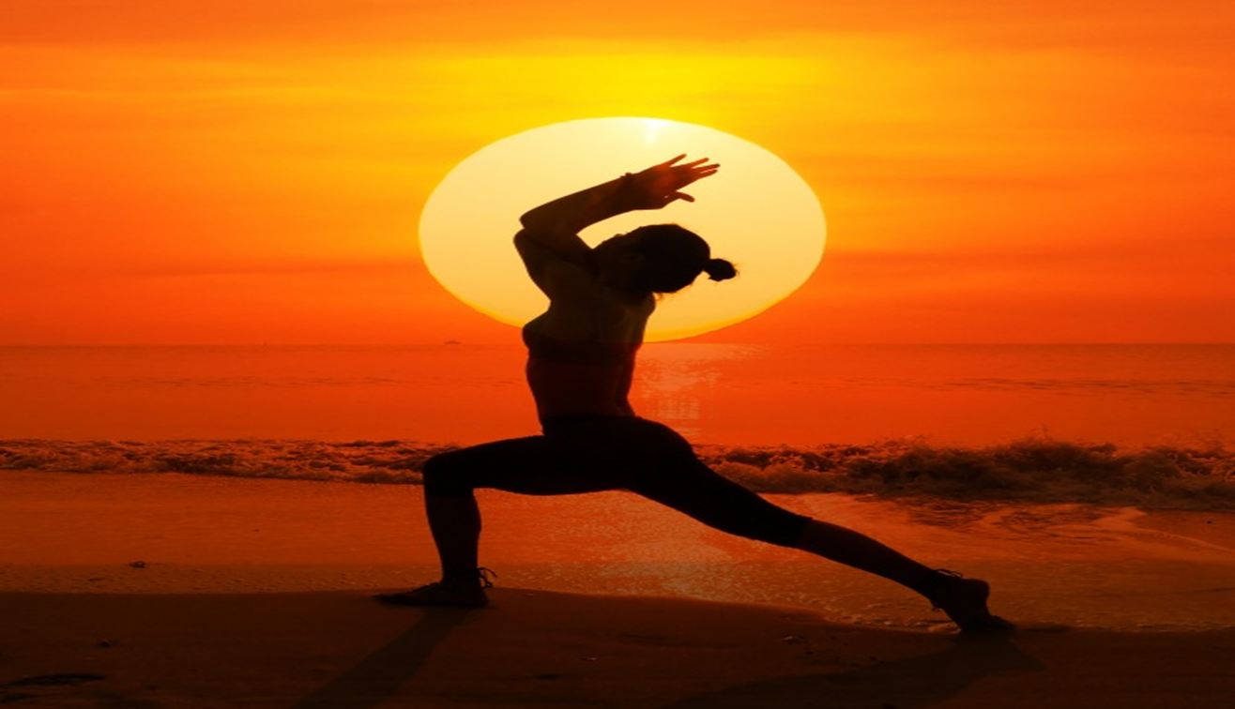
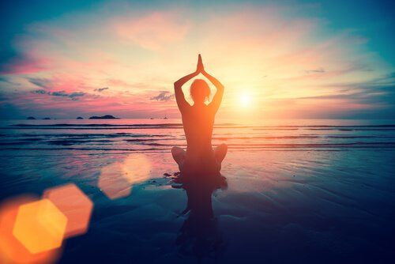
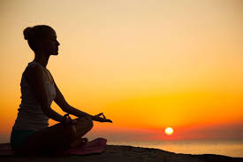
YOGA

Slide 3
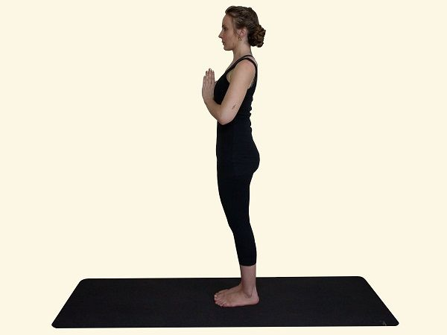
Pranamasana (Prayer Pose)

Slide 4
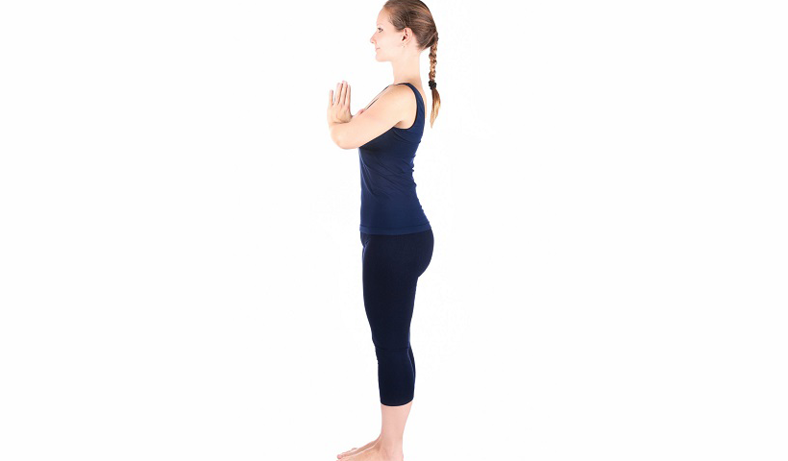
How To Do Prayer Pose (Steps)
Stand on the Yoga mat in an erect position by making sure your feet are placed together perfectly.
Bring your palms together facing each other parallel to the chest in Namaskar posture.
Make sure your eyes are looking straight parallel to the ground.

Slide 5
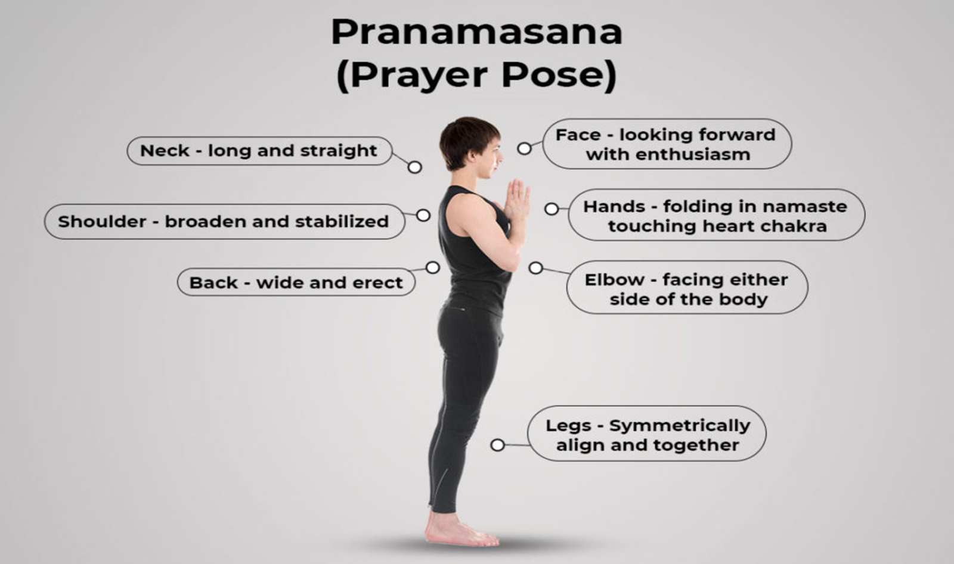

Slide 6
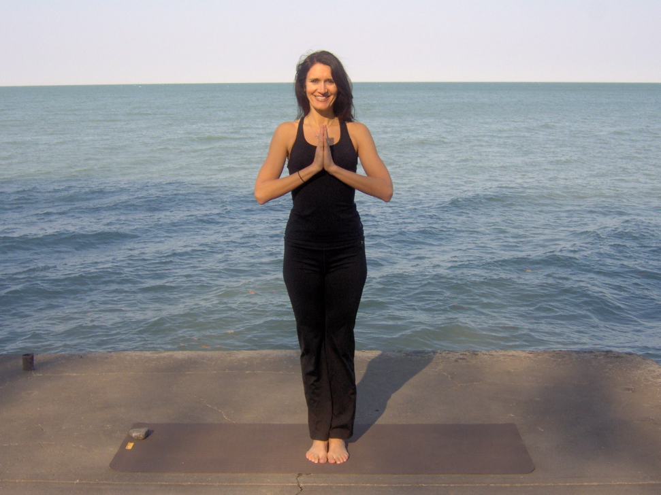
Benefits of Pranamasana
Opens up your chest area
Improves respiratory system
Improves your body posture
Aligns and strengthens the shoulders
Helps with controlling your anger

Slide 7
Variations of Prayer pose
1. Sitting Prayer pose (Cross-legged, in lotus and legs out straight)
2. Squatting Prayer pose (Keep feet hips’ width distance apart)
3. Reverse Prayer Pose

Slide 8
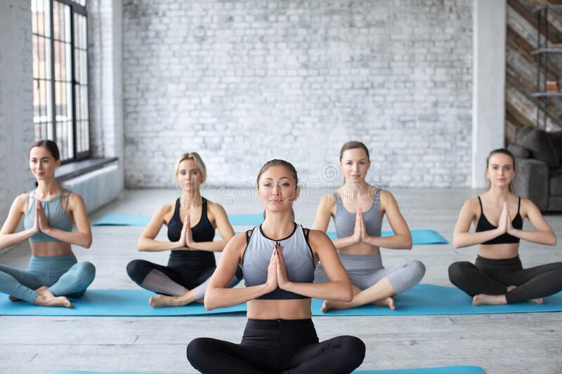
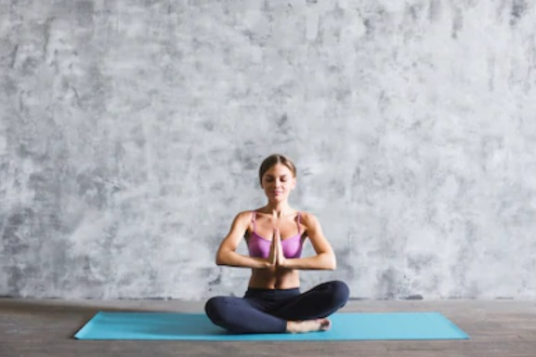
1. Sitting Prayer pose (Cross-legged, in lotus and legs out straight)

Slide 9
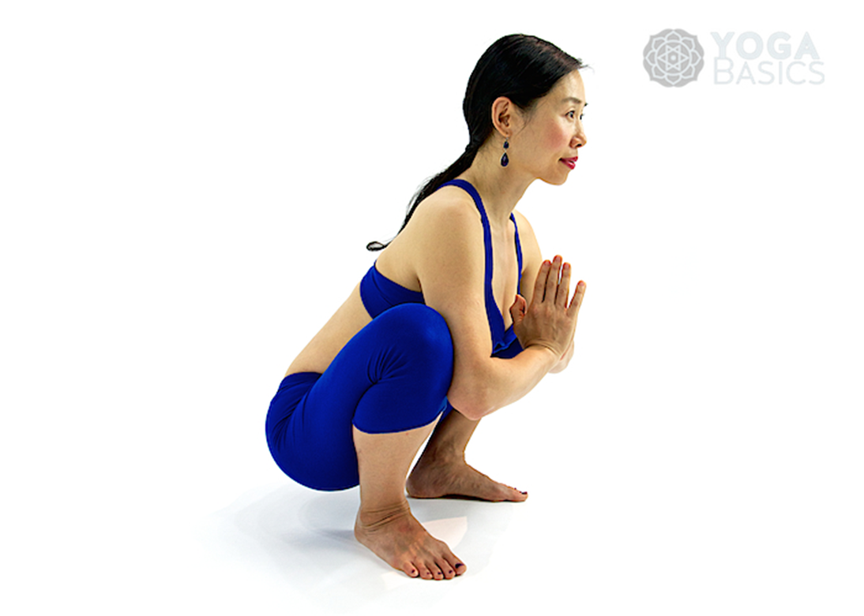
2. Squatting Prayer pose (Keep feet hips’ width distance apart)

Slide 10
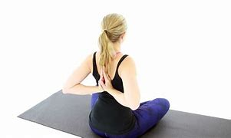
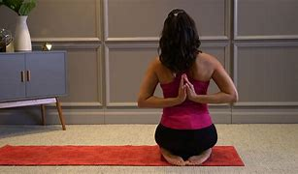
3. Paschim Namaskarasana (Reverse Prayer Pose)

Slide 11
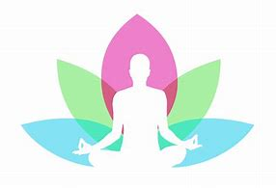


Slide 12
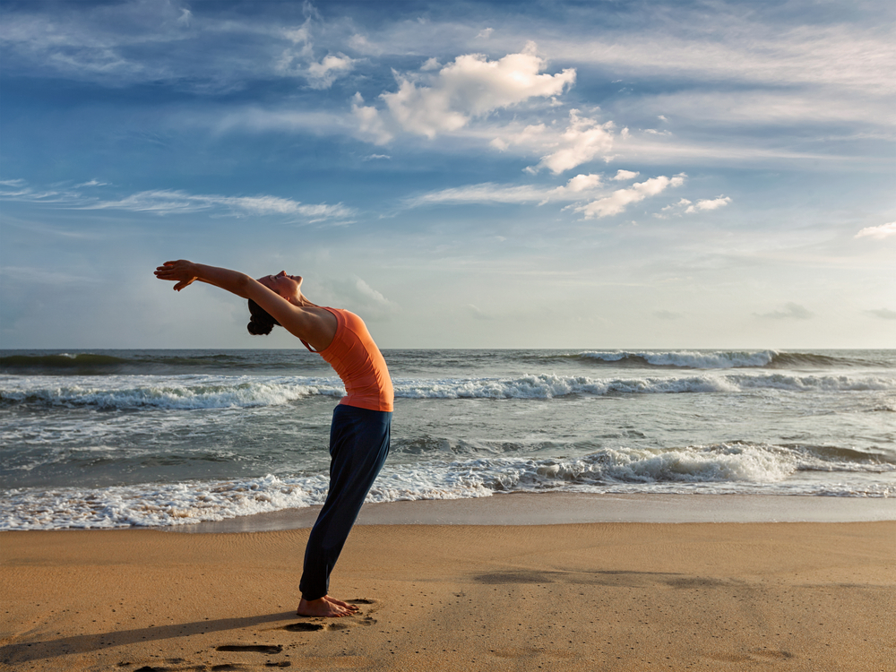
Hastauttanasana (Raised arms pose)

Slide 13
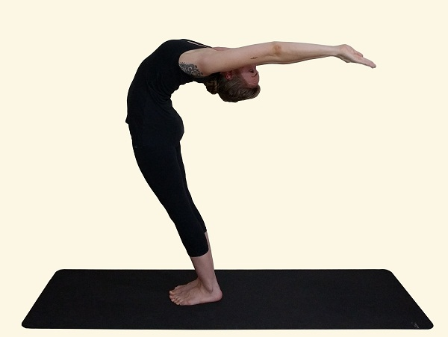
Method Of Doing Hasta Uttanasana
First of all, you stand on the floor placing both legs together
Taking your both hands in your front form the Prayer Mudra
After forming the prayer mudra take your hands over your head
Turn your neck backward along with the palms
Leaving the breath, bring both arms straight in the line to the shoulders

Slide 14
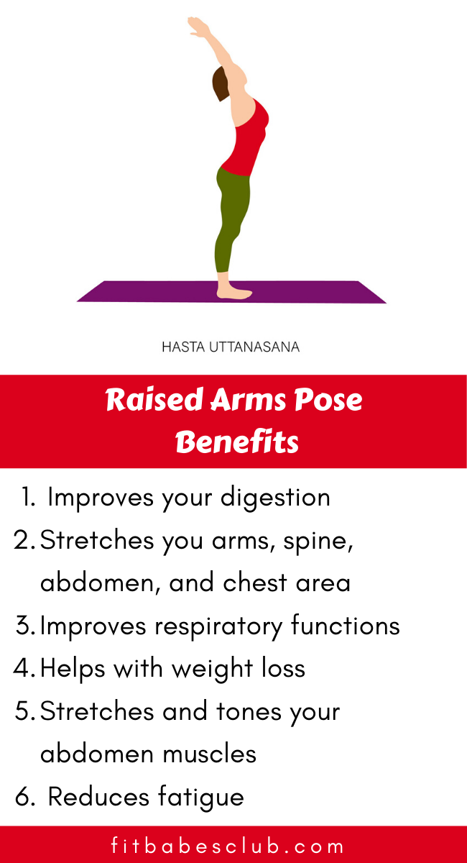

Slide 15
Precautions to take while doing Hasta Uttanasana
Practice it on empty stomach only.
Do not over-push your body while practicing it.
If you’ve back injury then don’t practice it.

Slide 16
THANKS TO ALL

